Slide 1
Static Single Assignment
Bojian Zheng
CSCD70 Spring 2018
bojian@cs.toronto.edu

Slide 2
Recap: What is SSA
What is SSA?
  SSA is a rule which states that each variable cannot be assigned more than once in the program text.

Slide 3

Recap: Three Algorithms
Dominance Frontier
$φ$ Placement
Variable Renaming

Slide 4
Dominance Frontier

Slide 5
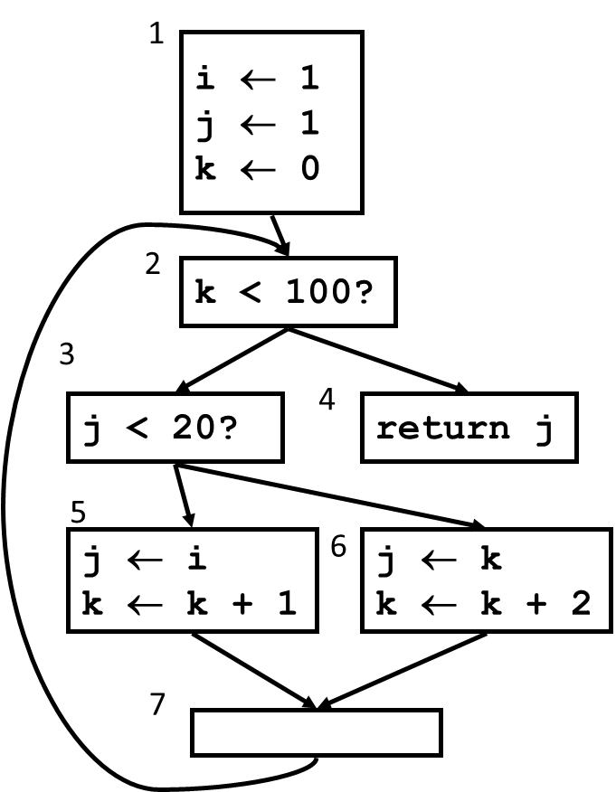
Dominance Frontier
What are the definitions of Dominance Frontier?

Slide 6
Dominance Frontier in LLVM
Implemented in llvm/Analysis/DominanceFrontierImpl.h (line 160) using worklist algorithm.
Has a wrapper pass that can be used as a prerequisite for other passes (needs to be specified inside AnalysisUsage).
  There is also similar wrapper pass for Dominator Tree: DominatorTreeWrapperPass

Slide 7
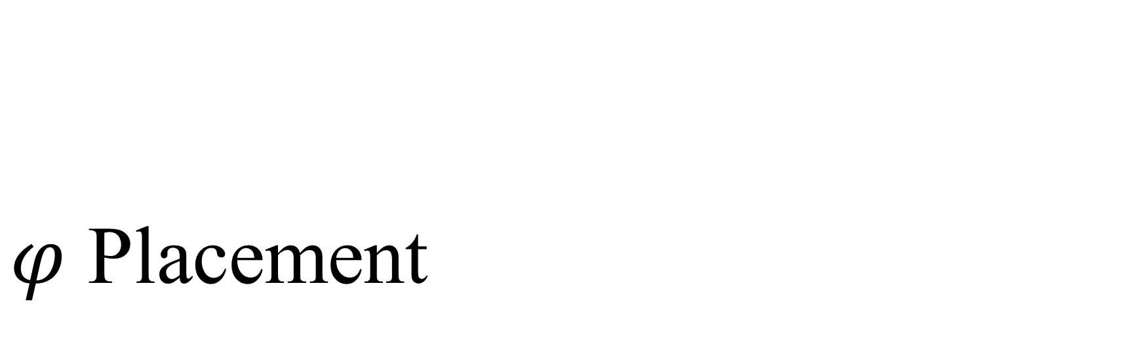
$φ$ Placement

Slide 8

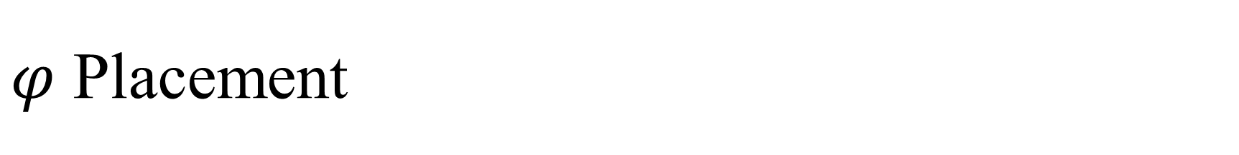
$φ$ Placement
Where should we place $φ$?
  $i$?
  $j$?
  $k$?

Slide 9
Rename Variables

Slide 10
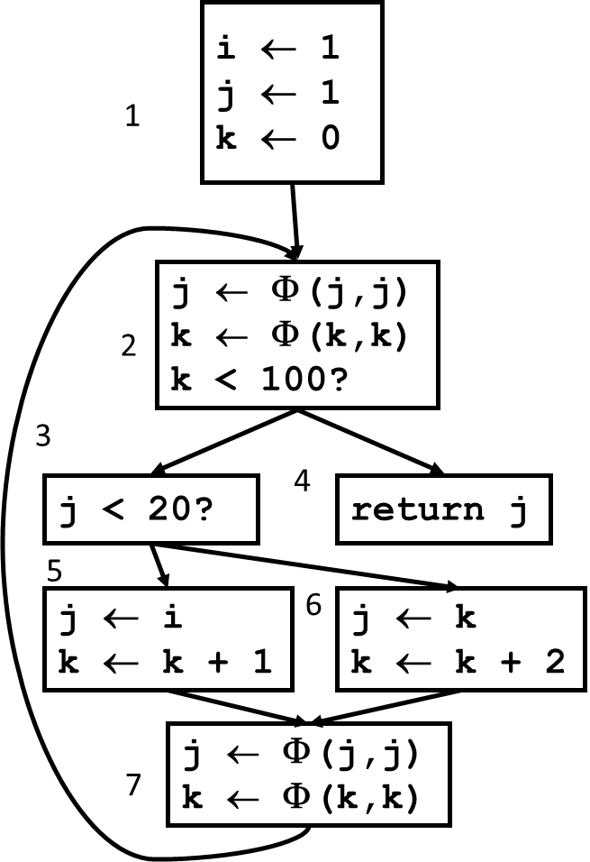
Rename Variables
Traverse through the CFG, and rename variables as we go.

